Slide 1
PROJECT
NAMES
ANSUMAN PASWAN
M.SHIRISHA
SREESHMA
T.RAHUL

Slide 2
LUNG CANCER PREDECTION
RANDOMFORESTCLASSIFICATION MODEL:
Random forest (or random forests) is an ensemble classifier that consists of many decision trees and outputs the class that is the mode of the class's output by individual trees.
The algorithm can be used in both classification and regression problems.
Random forests can also handle missing values. There are two ways to handle these: using median values to replace continuous variables, and computing the proximity-weighted average of missing values.

Slide 3
DATASET
In this dataset we have 60 rows and 7 columns
These 7 columns include name of Person , Surname , Age , Smokes , Area , Alcohol , Result
Smokes : how many times a person smokes in a day
Alcohol : how many times a person drinks in a day
Inputs columns : Age , Smokes , Alcohol
Output column : Result

Slide 4
STEPS TO IMPLEMENT RANDOMFOREST
The following are the steps to implement randomforest
Step1 : Importing libraries
Step2 : Creating a model
Step3 : Training the model with the past data
Step4 : Predicting the outcome

Slide 5
ALGORITHM
Each tree is constructed using the following algorithm:
Let the number of training cases be N, and the number of variables in the classifier be M.
We are told the number m of input variables to be used to determine the decision at a node of the tree; m should be much less than M.
Choose a training set for this tree by choosing n times with replacement from all N available training cases (i.e. take a bootstrap sample). Use the rest of the cases to estimate the error of the tree, by predicting their classes.
For each node of the tree, randomly choose m variables on which to base the decision at that node. Calculate the best split based on these m variables in the training set.
Each tree is fully grown and not pruned (as may be done in constructing a normal tree classifier).
For prediction a new sample is pushed down the tree. It is assigned the label of the training sample in the terminal node it ends up in. This procedure is iterated over all trees in the ensemble, and the average vote of all trees is reported as random forest prediction.

Slide 6
Random Forest Classifier
Random forest classifier creates a set of decision trees from randomly selected subset of training set. It then aggregates the votes from different decision trees to decide the final class of the test object.
It uses averaging to improve the predictive accuracy and control over-fitting.
Random forests is slow in generating predictions because it has multiple decision trees. Whenever it makes a prediction, all the trees in the forest have to make a prediction for the same given input and then perform voting on it. This whole process is time-consuming

Slide 7
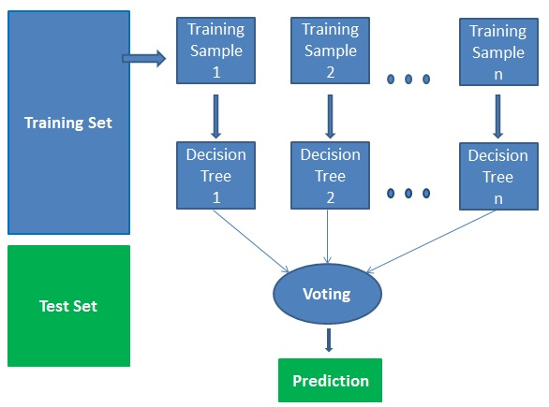
HOW ALGORITHM WORKS
.
It works In four steps:
1 . Select random samples from a given dataset.
2 . Construct a decision tree for each sample and get a prediction result from each decision tree.
3 . Perform a vote for each predicted result.
4 . Select the prediction result with the most votes as the final prediction.

Slide 8
RESULT: we have predicted whether a person can have lung cancer or not.
In [63]:
CONCLUSION : If we train the model with the dataset which is considered as the past data and then it can predict whether a person can have lung cancer or not by using suitable algorithm.

